Slide 1


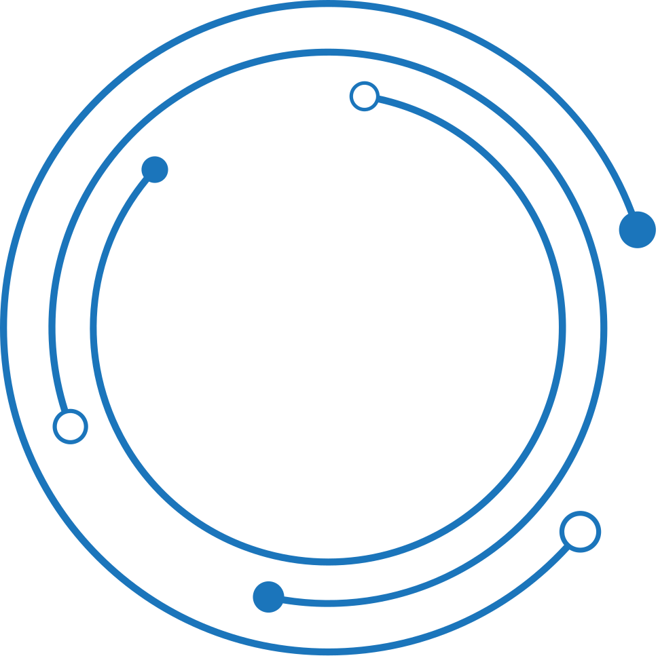
Blockchain
Crypto conquerors
PROJECT PROPOSAL

Slide 2

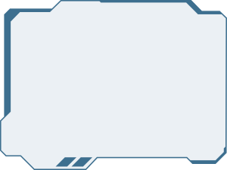

Problem statement
Traditional thrift stores face significant challenges in managing inventory, ensuring the authenticity of items, and maintaining transparency in transactions. Customers often struggle with verifying the provenance and quality of second-hand goods, leading to trust issues and inefficiencies. Additionally, manual inventory management systems are prone to errors and lack real-time updates. This project addresses these issues by applying blockchain technology to create a decentralized application (DApp) that uses smart contracts to automate and secure transactions, enhance item provenance tracking, and provide a transparent, tamper-proof ledger for all interactions.

Slide 3

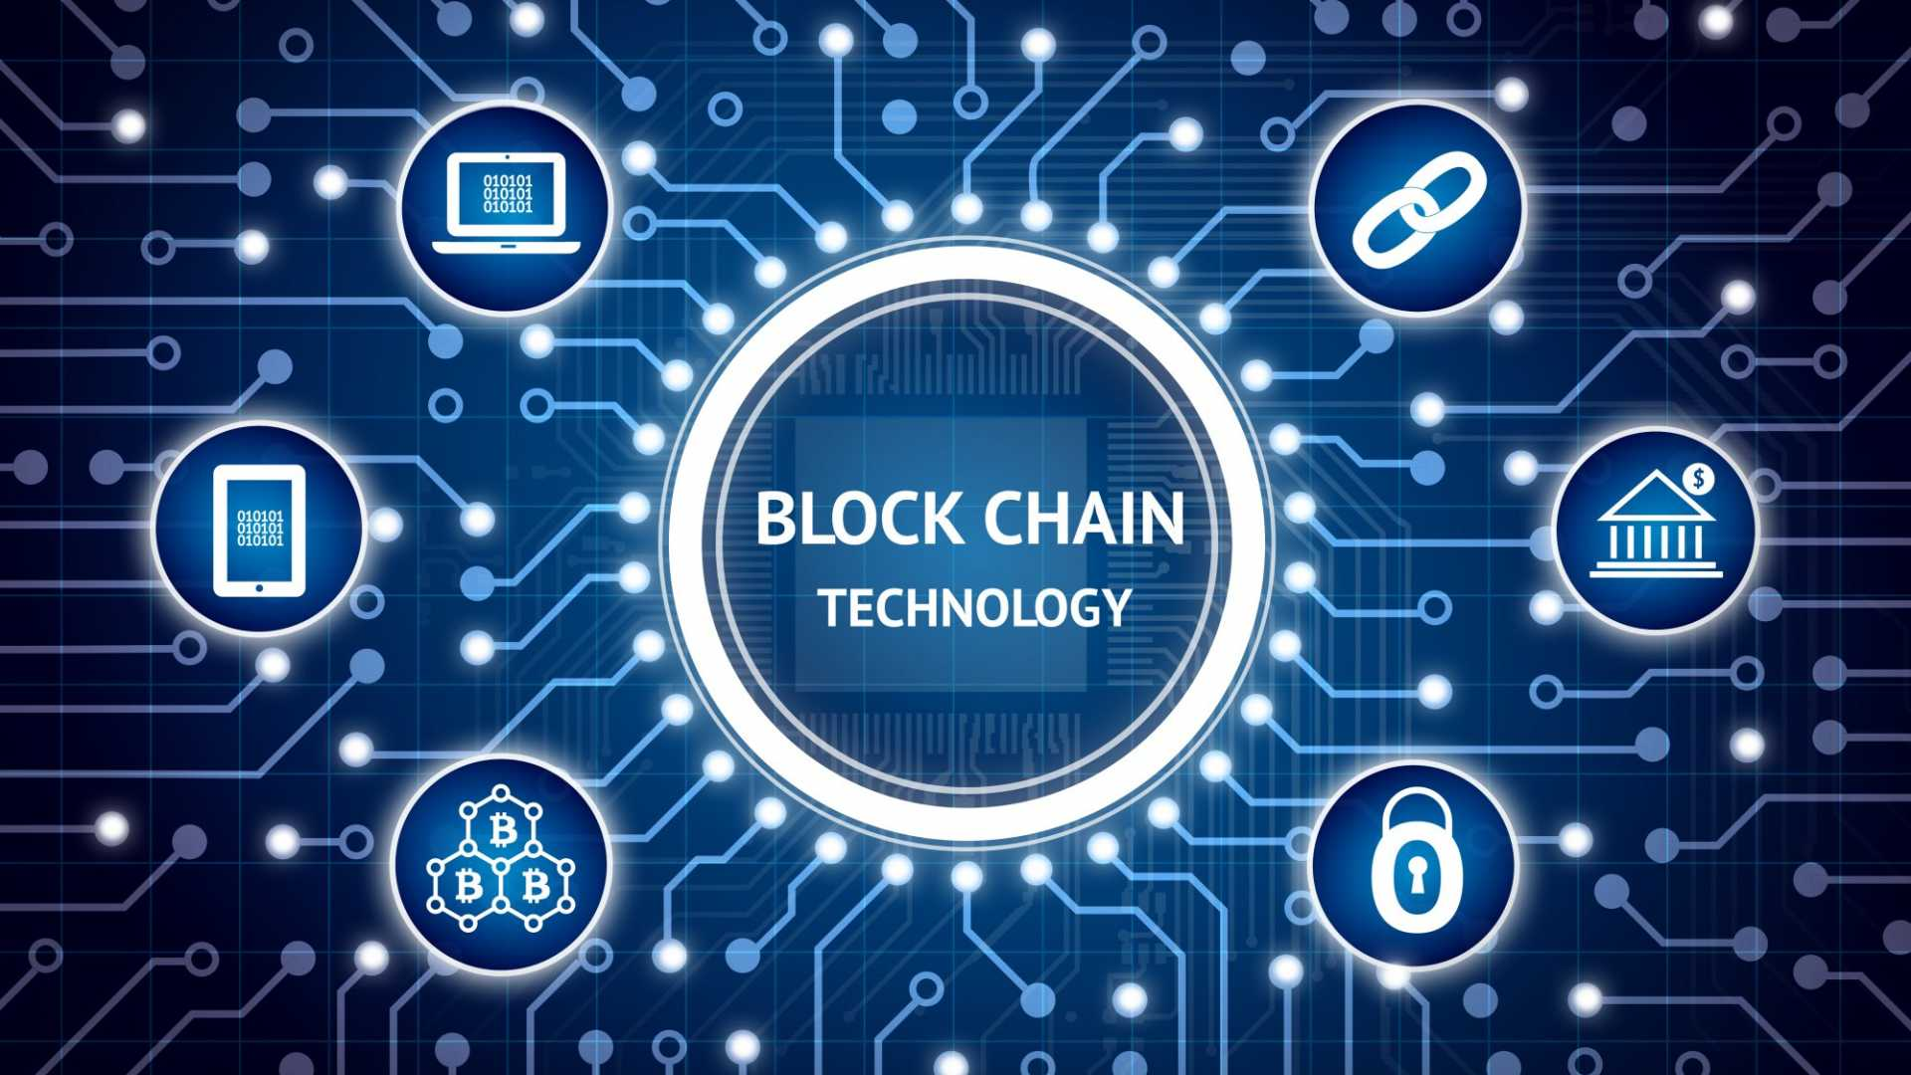
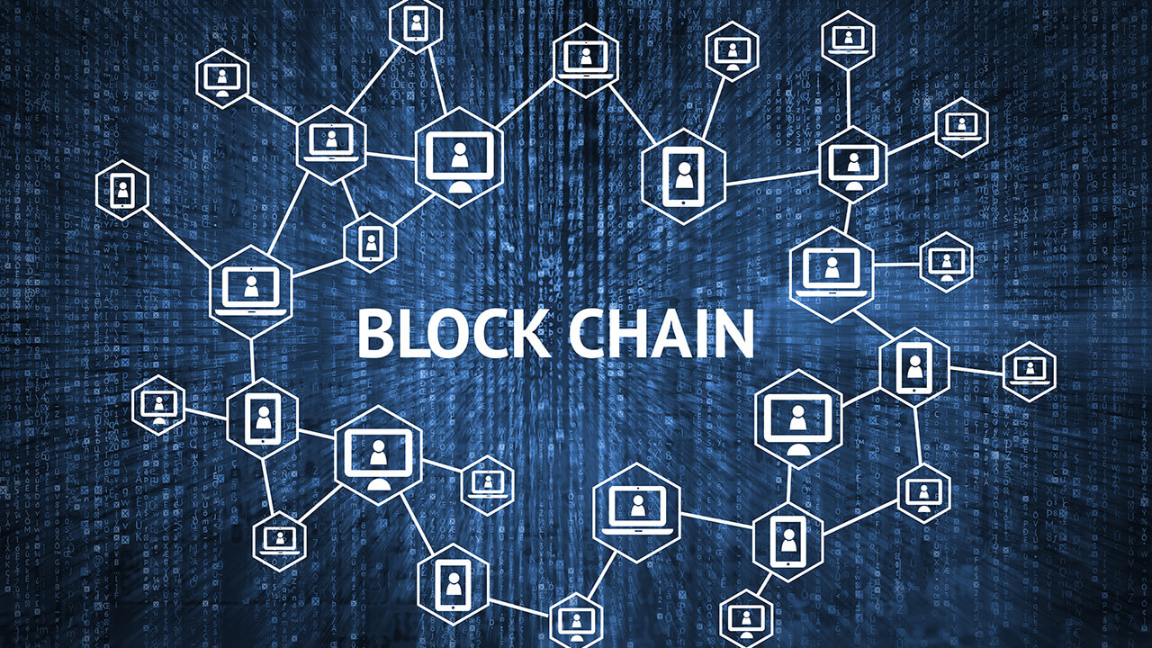
Project Overview
According to earth.org 1. 92 Million Tonnes of textiles waste is produced every year
Of the 100 billion garments produced each year, 92 million tonnes end up in landfills. To put things in perspective, this means that the equivalent of a rubbish truck full of clothes ends up on landfill sites every second. If the trend continues, the number of fast fashion waste is expected to soar up to 134 million tonnes a year by the end of the decade.
This project involves developing a decentralized thrift store application using Ethereum blockchain, smart contracts, and IPFS for secure transactions, ownership tracking, and decentralized file storage. The app features user registration, item listings, secure payments, and a transparent transaction history, integrated with MetaMask for user wallet management.
02

Slide 4
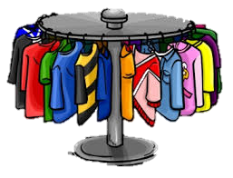
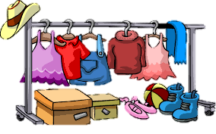
Sustainablity
Reduced Waste: By facilitating the resale and reuse of second-hand items, the DApp promotes a circular economy, which reduces waste and minimizes the environmental impact associated with producing new goods.
Efficient Resource Use: The DApp's digital nature eliminates the need for physical infrastructure like extensive store locations and paper-based records, leading to more efficient resource use and lower carbon footprints.
Blockchain Transparency: Blockchain technology provides transparent and immutable records of transactions, which enhances accountability and supports sustainable practices by ensuring that all items are sourced and managed responsibly.
Enhanced Item Lifecycle Tracking: The DApp’s provenance tracking features enable users to see the entire history of an item, promoting better decision-making and encouraging the purchase of items with verified, sustainable origins.
Energy-Efficient Technologies: Implementing energy-efficient block chain solutions, such as layer-2 scaling techniques or using eco-friendly block chain networks, can help mitigate the environmental impact of maintaining the decentralized infrastructure.
Promoting Local Economies: By connecting buyers and sellers directly, the DApp supports local economies and reduces the need for long-distance transportation, further lowering the overall environment.

Slide 5

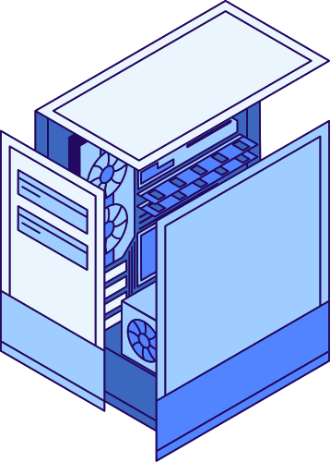
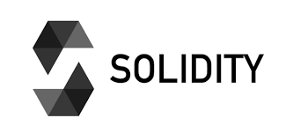
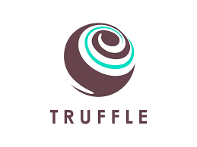
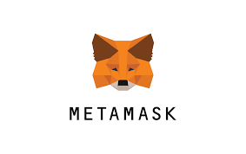
Tech stacks
Solidity is used to write smart contracts on the Ethereum blockchain, enabling the automation of transactions and enforcement of rules within decentralized applications. It allows developers to create self-executing contracts with predefined conditions, ensuring secure and transparent interactions.
Truffle in blockchain refers to a development framework for Ethereum, offering tools for smart contract development, testing, and deployment. It includes Truffle for the development environment, Ganache for a personal blockchain, and Drizzle for front-end libraries.
MetaMask is a cryptocurrency wallet and gateway to blockchain applications. It allows users to interact with Ethereum-based decentralized applications (dApps) directly from their web browser by managing their Ethereum wallets, securely storing private keys, and facilitating transactions.

Slide 6


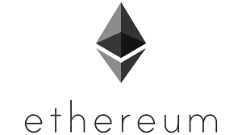
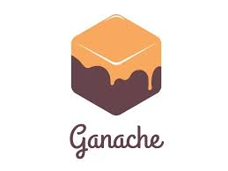
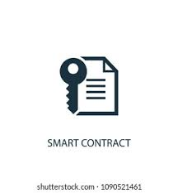
Tech stacks
Ethereum is a versatile blockchain platform that facilitates a wide range of applications. Its most notable feature is the ability to create and execute smart contracts, which are self-executing contracts with the terms directly written into code. This capability enables the development of decentralized applications (dApps) across various sectors, including finance, gaming, social networks, and supply chain management.
Ganache is a tool in the Truffle Suite for Ethereum development, providing a local blockchain for testing smart contracts and dApps. It enables faster iteration, debugging, and comprehensive logging. Developers can simulate various network conditions and use its user-friendly interface to manage accounts and inspect contract events and transactions.
They automate and enforce agreements without intermediaries, ensuring transparency and trust. Key uses include automating transactions, managing decentralized applications (dApps), and enabling decentralized finance (DeFi) services such as lending, borrowing, and trading. Smart contracts also facilitate the creation and transfer of digital assets, including fungible tokens (ERC-20) and non-fungible tokens (NFTs). Additionally, they power Decentralized Autonomous Organizations (DAOs), allowing for governance and decision-making through community voting without centralized control, enhancing efficiency and reducing costs across various industries.

Slide 7
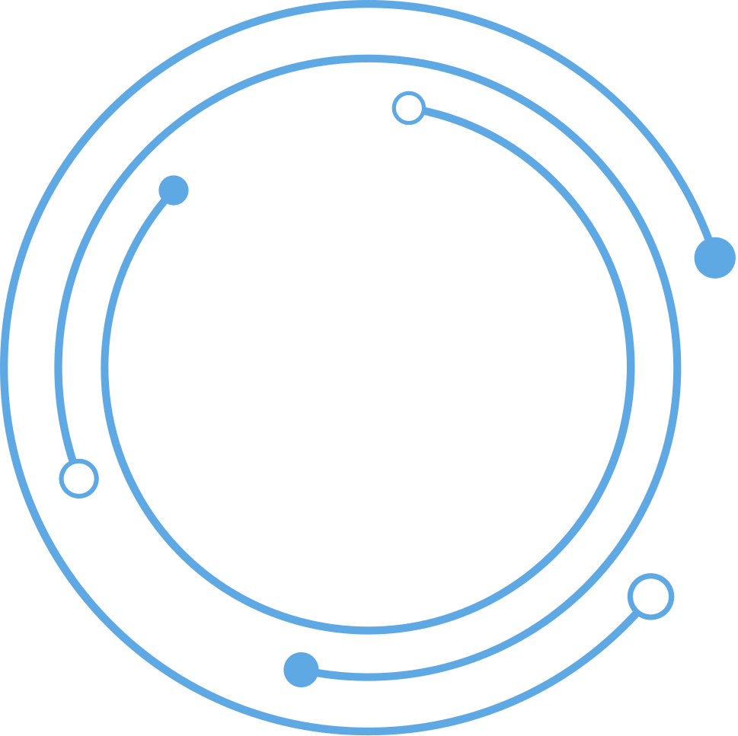
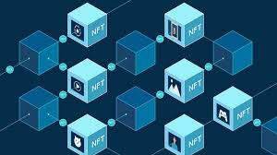
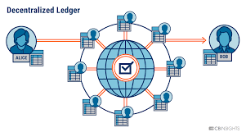
Implementation
The tech stacks for the blockchain-based thrift store dApp are implemented and deployed through a series of structured steps. First, smart contracts are developed using Solidity and Truffle Suite, tested on a local Ethereum blockchain with Ganache, and deployed to the Ethereum main net.
The frontend is built with React.js and Drizzle for seamless interaction with the smart contracts, using Redux for state management.
The application is hosted on services like Netlify or AWS S3, ensuring secure and accessible deployment. MetaMask is integrated to manage user wallet connections, enabling users to sign in and approve transactions directly from their wallets. Transaction handling functions are implemented for secure and user-friendly interactions.

Slide 8
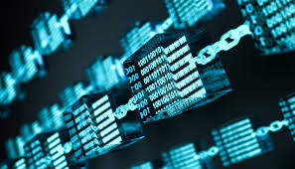
Overall solution
User Registration and Authentication : Secure registration using MetaMask and Wallet-based authentication for enhanced security.
Item Listing : Users can list items for sale with detailed descriptions and images by the use of Decentralized storage of images using IPFS
Item Search and Browsing : Search functionality with filters for easy item discovery and it can be categorized by browsing for a better shopping experience.
Payment Integration : Crypto currency payments for secure and instant transactions and Integration with MetaMask for seamless payment processing.
Shopping Cart : Add multiple items to a shopping cart for consolidated checkout so it is used to view and manage the cart.
User Profile Management : Manage user information, wallet address, and transaction history . It view and edit listed items and reviews.
Smart Contract-based Transactions : Automated and secure transactions using Ethereum smart contracts. Transparent and immutable transaction records.

Slide 9
Thank you
Web3 summer school hackathon

